Slide 1
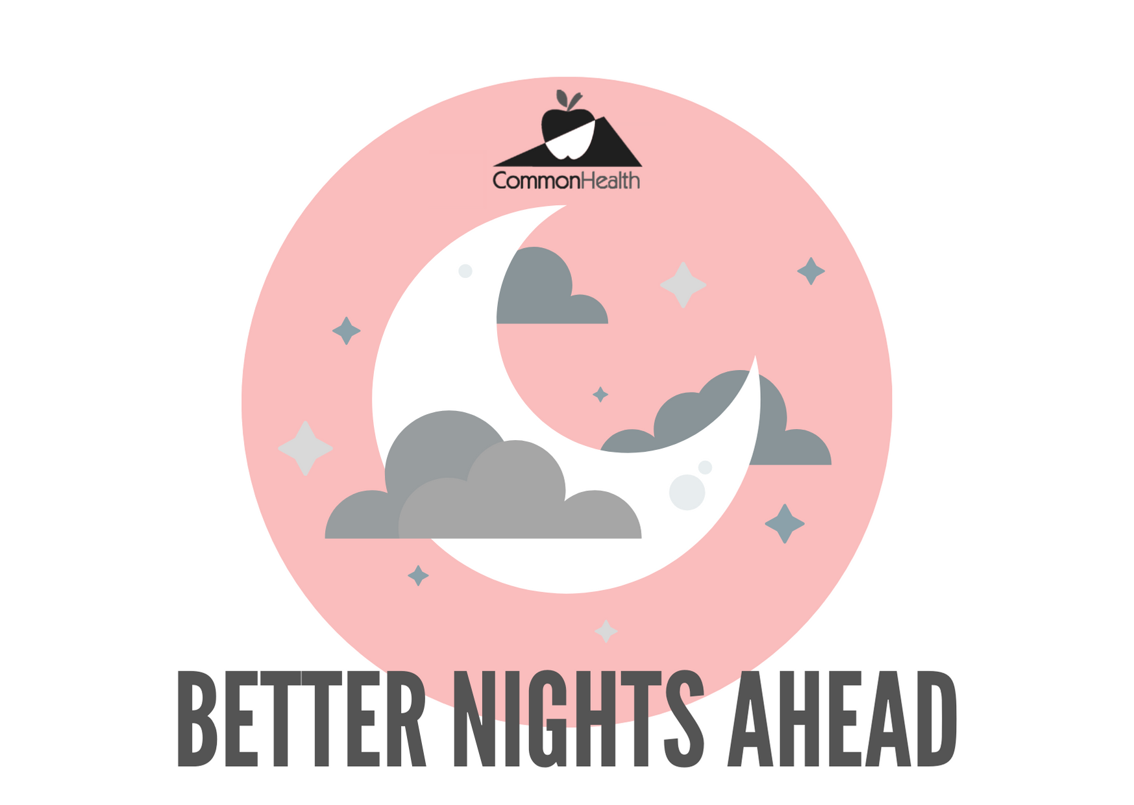
SLEEP GUIDE

Slide 2



Immunity
SLEEP IS VALUABLE
Mood
Better Memory
Decision Making
Heart Health
Less
Inflammation
Weight Control
Attention
Physical Performance
Stress Management
Energy
Creativity
Notes:
When you’re in a rush to meet work, school, family, or household responsibilities, do you cut back on your sleep, thinking it won’t be a problem? Like many people, you might think that sleep is merely a “down time” when the brain shuts off and the body rests. Think again. From mood to metabolism, sleep is essential to keeping us healthy. And in these challenging times, it’s good to know why sleep is so important.
A number of aspects of your health and quality of life are linked to sleep, and these aspects are impaired when you are sleep deprived.
Sleep optimizes how our brain works, including regulating emotions, mood, attention span, concentration and executive function, which helps us make good judgments, remain flexible, and be creative.
Exercise and sleep both combat stress and can bolster health and mood. Regular exercisers report better, more sound sleep than non-exercisers. In addition, exercise and a healthy diet boost our body’s immune system, reduces inflammation, and improves stress management.

Slide 3

FALSE
TRUE OR FALSE
You can get by on 4 hours of sleep
Notes:
Before we get started planning our strategy for better sleep, let’s look at a few sleep related questions that many struggle with.
You can get by on 4 hours of sleep. – FALSE
For most of us, 7-8 hours is the “sweet spot” for sleep – and makes a huge difference in our alertness, moods, productivity, and overall wellbeing. Although people can get used to decreased amounts of sleep, with their circadian rhythms adjusting, habitual insufficient sleep can lead to metabolic, mental health, and immunological health consequences. People whose sleep is restricted do report their feelings of sleepiness level off, yet their inability to stay awake increases.

Slide 4
TRUE
TRUE OR FALSE
A short daytime nap can be good for you
Notes:
A short daytime nap can be good for you. – TRUE
If they are possible in your routine, naps are a great way to re-energize and improve performance in the workplace. Try to keep the naps under 20 minutes or they may interfere with nighttime sleep.

Slide 5

FALSE
TRUE OR FALSE
Drinking alcohol will help you sleep better
Notes:
Drinking alcohol will help you sleep better – FALSE
While a drink or two may help you fall asleep quickly, alcohol often leads to lighter, less restorative sleep, and increased wakefulness during the night.

Slide 6
FALSE
TRUE OR FALSE
Exercising before bed is never a good idea
Notes:
Exercising before bed is never a good idea. – FALSE
Researchers have shown no adverse effect of nighttime exercise on sleep. In fact, exercise and sleep can be mutually beneficial. As long as you allow proper opportunity to wind down afterward, your workout can be scheduled before bed as “better late than never.”

Slide 7
FALSE
TRUE OR FALSE
You can catch up on sleep on the weekend
Notes:
You can catch up on sleep on the weekend. – FALSE
Although this sleeping pattern will help you feel more rested, it will not completely make up for the lack of sleep or correct your sleep debt. This pattern also will not necessarily make up for impaired performance during the week or the physical problems that can result from not sleeping enough. Furthermore, sleeping later on the weekends can affect your biological clock, making it much harder to go to sleep at the right time on Sunday nights and get up early on Monday mornings. Instead, stick to a routine to ensure regular, restful sleep.

Slide 8
FALSE
TRUE OR FALSE
Tossing and turning will eventually lead to sleep
Notes:
Tossing and turning will eventually lead to sleep. – FALSE
Tossing and turning is an anxiety-ridden activity that will not be helpful for rest. If you find yourself still awake after staying in bed for more than 20 minutes or if you are starting to feel anxious or worried, get up and do some relaxing activity until you feel sleepy. The anxiety of not being able to sleep can make it harder to fall asleep.

Slide 9

BEDROOM BASICS
COOL
DARK
QUIET
Notes:
Now, let’s cover the basics…
Have a good sleeping environment. Get rid of anything in your bedroom that might distract you from sleep, such as noises, bright lights, an uncomfortable bed, a TV/computer in the bedroom, or warm temperatures. You sleep better if the temperature in the room is kept on the cool side. A TV, cell phone, or computer in the bedroom can be a distraction and deprive you of needed sleep. Having a comfortable mattress and pillow can help promote a good night’s sleep. Individuals who have insomnia often watch the clock. Turn the clock’s face out of view so you don’t worry about the time while trying to fall asleep.

Slide 10
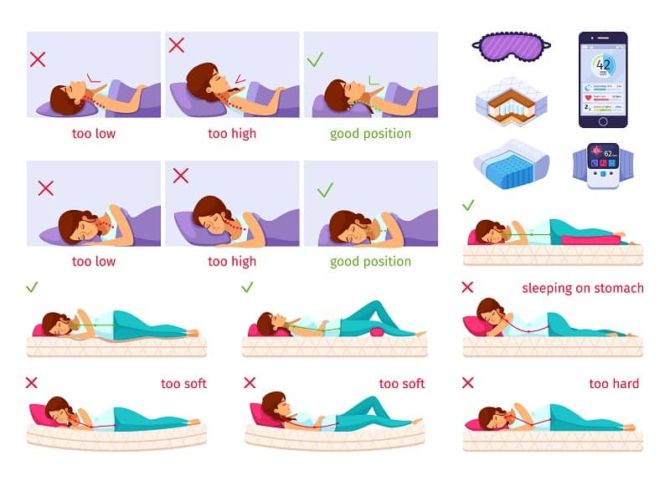
PERFECT PILLOWS
Notes:
Your pillow’s most important job is to support you in your go-to sleeping position, all night long. The right pillow should keep your head, neck, and spine, all in neutral alignment, and support the natural curvature of your spine. Keeping a neutral spine not only alleviates neck pain, it also relieves pressure throughout your entire body.
Pro Tip: If you’re not exactly sure how to tell if your spine is in neutral alignment, check to make sure your ears are in line with your shoulders, and your chin is in line with your sternum.
Your type of pillow will depend upon which position you prefer to sleep:
Back sleepers should look for medium loft and medium firmness (see above).
Side sleepers look for high loft, firm support, and shapeable fill to take pressure off the shoulder.
Stomach sleepers need low loft, soft support and compressible fill to relieve the twisting pressure on the neck.
For more visit: https://sleepopolis.com/guides/right-pillow-how-to-choose/

Slide 11
SLEEP POSITIONS
Notes:
When it comes to stomach sleeping, finding the perfect pillow can be a little tricky. In fact, some experts suggest avoiding the prone position altogether, as it tends to position the upper cervical spine at end-range rotation or extension. Essentially, this means you’re at greater risk of straining your neck, and putting pressure on your lower back or abdomen.
Stomach sleepers also tend to embrace the underside of the pillow rather than lie with their arms at their side. This may result in shoulder pain as well as the neck, back and hip problems associated with stomach sleeping.
There are corrective pillows that you can try (as well as the tennis ball in a tshirt trick) to help you learn a new sleeping position.

Slide 12
MATTRESS ISSUES
Notes:
When it comes to sleep environment, have a supportive and comfortable mattress is critical. Mattresses last 5 to 10 years as a rule. However, you should decide when it is time to replace your mattress based off other warning signs. Are you waking up sore? Is your mattress feeling lumpy? Do you sleep better on other mattresses, like at a hotel? These are all signs that it is time to go shopping.
Laying down in the store isn't the only way to go anymore. New mattress-in-a-box companies have won over thousands of customers with convenient shipping and free trial periods. Here is what you need to know about both. Go the traditional route if you want to choose from a greater variety and feel the mattress before buying it. Most stores will also offer removal of your existing mattress. The downside is it can feel overwhelming and it is harder to compare prices to know if you are getting a good deal.
A big mistake is rushing the decision by quickly lying down on many different mattresses to find the one that feels best. If you’re going to invest in a mattress, take the time to recline for a while (at least 10 minutes) and make sure you do not feel any pressure or pain. In a mattress store, you should never pay full price. Always shop the sales, and don't be afraid to negotiate with the salesperson.
Shopping online is the newer route and offers a great alternative for people who hate shopping for mattresses because there are fewer options to compare and no sales clerks to deal with. These mattresses generally arrive in a box at your doorstep within a few days and include free shipping and a money-back guarantee (even if you simply do not like the mattress!) so there is minimal risk. The downsides are that you typically have to set it up yourself and deal with getting rid of your old mattress. Online, the price is usually final, but it does not include markups for being sold at a physical store.
Always check the return policy. You may get a partial refund if you bought it in a store, but online mattress companies often arrange to pick it up for a local charity and will give 100% of your money back. Make sure you can test out a new mattress for at least a month risk-free; this way you can get used to it before making a decision. Keep in mind that a longer warranty may not promise a certain lifespan, if you read the fine print. If the mattress is stained because you didn't use a mattress protector, or if you don't use a matching foundation (like a box spring) beneath the mattress, it could invalidate the warranty. So, don't forget to extend the life of your new pad by using a mattress protector, which can keep out keep out dust, allergens, spills, and other hazards.
Some perceptive manufacturers make a hybrid-style mattress that combines the buoyancy of an innerspring core with the motion isolation of memory foam. It's a best-of-both-worlds option that can satisfy many partner disputes and sleeping styles.

Slide 13

Reset your Sleep Cues
Relax your entire face
(even the muscles inside your mouth)
Drop your shoulders and release your arm muscles down through your hands
Deeply inhale
Exhale and relax your chest in all directions - Inhale
Exhale and release your hips and legs down to the feet
Notes:
If you find yourself spending more time trying to fall asleep than actually sleeping, you’re not alone. Just the act of trying too hard can cause (or continue) a cycle of anxious, nerve-wracking energy that keeps our minds awake. And if your mind can’t sleep, it’s really difficult for your body to follow. But there are scientific tricks you can try to flip the switch and guide your body into a safe shutdown mode.
Try these basic methods to help reset your sleep cues:
Relax your entire face (even the muscles inside your mouth).
Drop your shoulders and release your arm muscles down through your hands.
Deeply inhale.
Exhale and relax your chest in all directions.
Inhale.
Exhale and release your hips and legs all the way through the soles of the feet.
Continue your inhalation and exhalation while you imagine how you feel in a relaxing setting.

Slide 14

Alternate Technique
Get ready by placing your tongue on the roof of your mouth,
just behind your front teeth
Exhale with your lips slightly open
Close your mouth and inhale through your nose as you count to 4
Gently hold your breath for a count of 7
Exhale gently for a count of 8
Complete this cycle four times (or less if you fall asleep!)
Notes:
Minding your breath is another wonderful exercise for preparing your body for relaxation and sleep.
4-7-8 Breathing
Get ready by placing your tongue on the roof of your mouth, just behind your front teeth.
Exhale with your lips slightly open.
Close your mouth and inhale through your nose as you count to 4.
Gently hold your breath for a count of 7.
Exhale gently for a count of 8.
Complete this entire cycle four times (or less if you fall asleep)!
P.M.R. (Progressive Muscle Relaxation)
Progressive muscle relaxation, also known as deep muscle relaxation, is another technique that helps you unwind.
The premise is to tense — but not strain — your muscles and relax to release the tension. This movement promotes tranquility throughout your body. It’s a trick recommended to help with insomnia.
Before you start, try practicing the 4-7-8 method while imagining the tension leaving your body as you exhale.is an excellent technique that may prove to be helpful in getting you to sleep. The steps for P.M.R. include:
Raise your eyebrows for 5 seconds.
Relax and chill for 10 seconds.
Smile huge for 5 seconds.
Let in go and release your cheeks for 10 seconds.
Stretch your chin upwards for 5 seconds.
Let your head go heavy into the pillow for 10 seconds.
Continue to tense (but not strain) and deeply relax your way down your body.
Let yourself drift off, even if you don’t make it all the way to your feet.

Slide 15
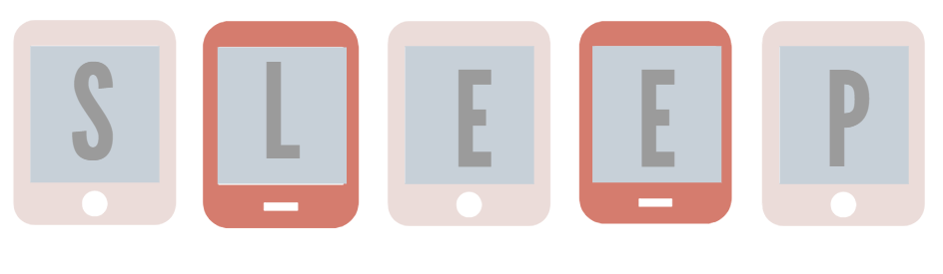
& screen time
Notes:
If you've been reading up on the effects of excessive screen time on one's health, chances are that you may have come across the term “blue light” more than a couple of times. This form of light has been found to have a disruptive effect on our sleep. While it may seem hard to believe, the verdict (and science) is out on the exact relationship shared between blue light and sleep quality.
Blue light is essentially light of a particular wave length out of the entire spectrum of light. This means digital devices are not the only source of blue light as it can occur naturally as well (with sunlight for example). However, artificial light sources such as those from digital devices and fluorescent light bulbs have been found to be more concentrated in blue light than any other sources. What exactly is so special about blue light that makes it so disruptive to sleep?
Blue light has such a profound impact on your sleep simply because it directly affects your body's production of the sleep hormone melatonin. So how does blue light affect this important sleep hormone? Melatonin is responsible for making you feel sleepy, and blue light suppresses the production of this important hormone. This is why sunlight wakes you up naturally in the morning and you tend to feel sleepier in dark environments. Even though your digital screens are such a small light source compared to natural sunlight, it still has significant effects on your sleep cycle.
Blue light’s role in maintaining melatonin levels in your body makes it a huge factor in controlling your body’s circadian rhythm. Your circadian rhythm is responsible for telling your body when it’s time to sleep and wake up, so any disturbances to this cycle will have an effect on your sleep. As a result, you may experience difficulty falling asleep or even staying asleep.
In short, blue light interferes with your sleep in two ways – first by disrupting your body’s production of sleep-inducing hormones, and second by throwing your body’s natural circadian rhythm off-balance. By negatively affecting the quality of our sleep, blue light exposure can prove to be really detrimental to our health. Apart from sleep-related issues, there are two other negative side effects of blue light exposure that are just as worrying.
Since we are on the topic of getting more blue light during the day, it’s a good time to raise the point that blue light does have its benefits too. Yes – exposure to blue light at night can disrupt your sleep and too much blue light is indeed bad for your eyes, but there are ways in which blue light can be beneficial too.
Blue light is stimulative by nature and can help to boost your alertness, improve your mood and fire up your memory. In addition, exposure to certain levels of sunlight is essential for maintaining health eyes and eyesight in children.
Blue light is also essential to regulating our Circadian Rhythm. Limiting blue light at night helps your circadian rhythm but getting zero blue light throughout the day won’t exactly do you any good. As mentioned previously, exposing yourself to blue light during daylight hours contributes to a healthy circadian rhythm and will help you sleep better at night!
Blue light may get a negative reputation when it comes to sleep quality and eye health, but it isn’t necessary to avoid blue light totally – you only need to minimize your blue light exposure at night. Maintaining a healthy sleep cycle is all about striking a balance between getting enough sunlight during the day and staying away from artificial light at night. Once you get into the rhythm of things, you are bound to notice the difference!

Slide 16
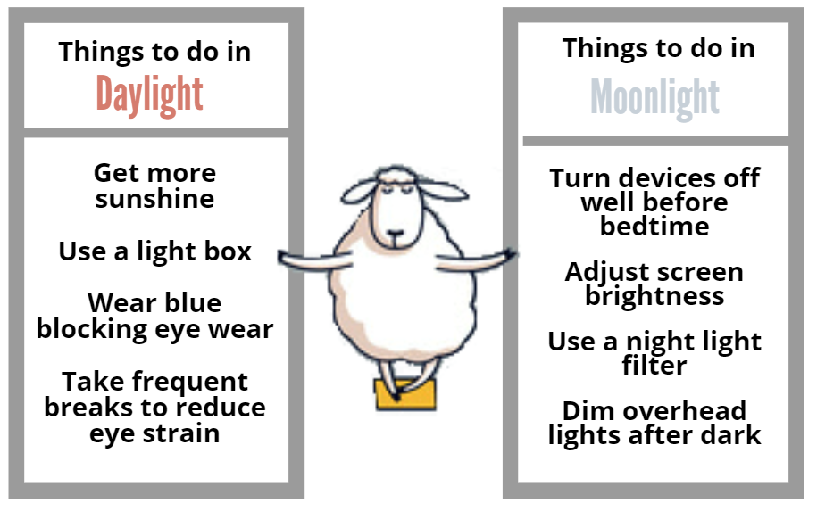
Notes:
During the day:
Get more sunshine.
Use a light box.
Wear blue blocking eye wear.
Take frequent breaks to reduce eye strain.
At night: Five Ways to Minimize Your Blue Light Exposure…
Put your devices away at least two hours before bedtime.
Adjust your screen brightness and turn on night light filters.
Use devices with smaller screens.
Change your home lights to warm lights or “smart” lights.
Get protective eye wear, such as blue light-blocking glasses.

Slide 17
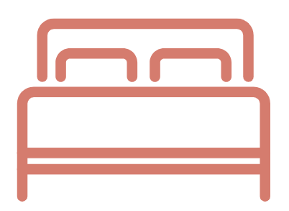
Take advantage of the afternoon slump
Limit your nap to about 20 minutes
Lie down
Meditate & relax
NAPS
Use earplugs
Use a sleep mask
Notes:
Napping is natural. Is napping good for you? When done correctly, the benefits of napping are numerous. Short naps (preferably 30 minutes or less) are associated with lowered risk of cardiovascular disease, improved productivity, and increased mental performance and learning.
Naps reduce your risk of heart disease
Afternoon naps can reduce the risk of cardiovascular disease, according to a report published in the Annals of Internal Medicine. Naps reduced the risk of heart problems about as much as statin drugs do (medication designed to lower cholesterol). People who napped at least 30 minutes a day, three times a week, were 37 percent less likely to die from heart disease. Occasional nappers had a 12 percent reduction.
Naps improve mental performance
Research continues to show that daytime napping can improve mental performance in adults. A study in 2006 concluded that regular naps of less than 30 minutes, and even a power nap as short as ten minutes, can improve productivity and mental performance.
If a nap on the weekend will fit into your lifestyle, here are a few tips to follow:
Take advantage of the afternoon slump, when your body is primed to fall asleep.
Don’t sleep in a seated position. It takes about twice as long to fall asleep sitting upright versus lying down.
Use ear plugs or an eye mask to block out extra light and noise.
Meditate and relax. Take slow, deep breaths.
Don’t sleep longer than 20-30 minutes. Set an alarm.

Slide 18

A coffee nap sounds good!
Notes:
The coffee nap is simple: you drink a cup of coffee and immediately take a 15 minute nap. Researchers found coffee helps clear your system of adenosine, a chemical which makes you sleepy. The combination of a cup of coffee with an immediate nap chaser provided the most alertness for the longest period of time in tests. The recommendation for a coffee nap is a bit shorter than a power nap – 15 minutes versus 20 minutes.

Slide 19
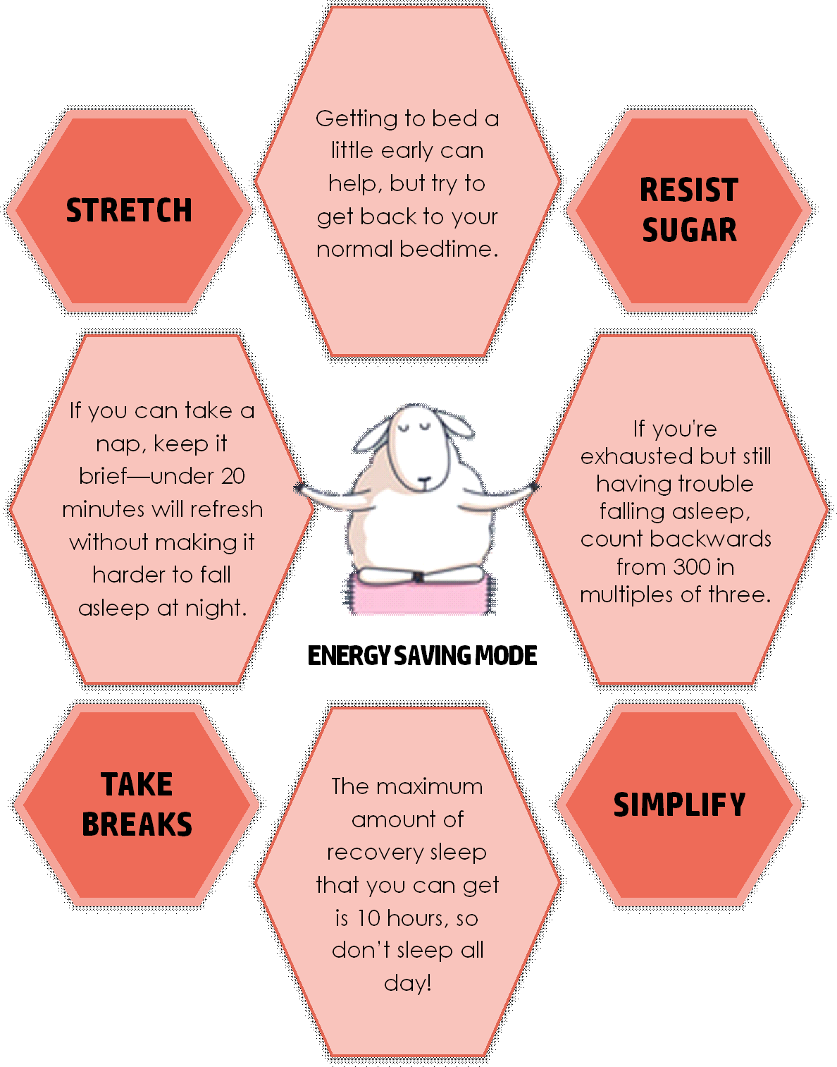

ROUGH
NIGHT
Notes:
Rough night last night? Everyone has a bad night of sleep now and then. Your life won’t wait until you’re rested, so you’ll need all the energy you can to get through today. Some of the nation’s leading sleep doctors offer tips on how to power through the day after a bad night’s rest.
Caffeine, in Moderation – Caffeine can help when you need an energy boost, as long as you don’t overdo it. Two cups of coffee, for instance, will give you about as much alertness as you’re going to get. Drinking more won’t make you fee more alert. If anything, it can give you the jitters. The same goes for over-the-counter supplements that promise to help you stay alert. Energy drinks can serve a purpose when used appropriately, but for the most part, usually do more harm than good. A good alternative would be to stick with plain black or green tea and coffee. Also, steer clear of all caffeine after 4:00pm to avoid problems falling asleep at night.
Don’t Rely on Sugar – When you’re seep deprived, you may be tempted to reach for a candy bar. Don’t. Sugar will give you quick energy, but it doesn’t last. You’ll just end up crashing later. Instead, stick to a balanced diet and put extra emphasis on protein-rich foods ike nuts and lean meats. Some good meal examples would be eating a salad with grilled chicken, or another lean protein, like fish with veggies for lunch or dinner. Some good breakfast suggestions would be eating protein-rich foods like eggs and plain Greek yogurt. If you have a sweet tooth, choose fruit, not a doughnut.
Take Breaks – After a bad night’s sleep, your attention span may drag a little more than usual. To keep focused, take breaks throughout the day. Go for a walk outdoors. Movement stimulates alertness in the brain, and the sunlight provides your body with natural cues to promote wakefulness. When you exercise, take it easy. Keep it light or moderate, not vigorous, when you’re exhausted. Take a brief nap, if you have time. Napping up to 25 minutes will help to recharge your body and mind, while taking a longer nap will make you drowsier than you already are.
Simplify Your Day – Let’s face it, you’re not at your best when you don’t sleep well. So lighten your work load as much as possible. By doing fewer things, you can still do a quality job without stressing out. You may also want to hold off on making any big decisions until after you’ve rested.
Avoid Driving – Drowsy driving is dangerous, since it can lead to accidents. Stay off the road as much as possible if you haven’t slept. If you absolutely can’t carpool or take transit, power nap before driving. Be particularly careful when driving in the early afternoon. Most people naturally drift around 1 or 2pm, and those who are sleep deprived will take a bigger hit.
Sleep in, a Little, Tonight – Sleeping in after a bad night’s sleep is OK, but you’re trying to get your sleep schedule back on track. Sleeping in too long can make that harder, because it shifts your normal sleep pattern. If you sleep in, limit it to no more than 2 extra hours. If you normally get 7 hours of sleep at night, aim for 9. Going to bed too earty can also disturb sleep patterns. If you’re exhausted and want to hit the sack, try to wait until it’s about an hour before your normal bedtime. No matter how tired you feel, there’s no reason to sleep all day, since the most recovery sleep time you can get is 10 hours.

Slide 20
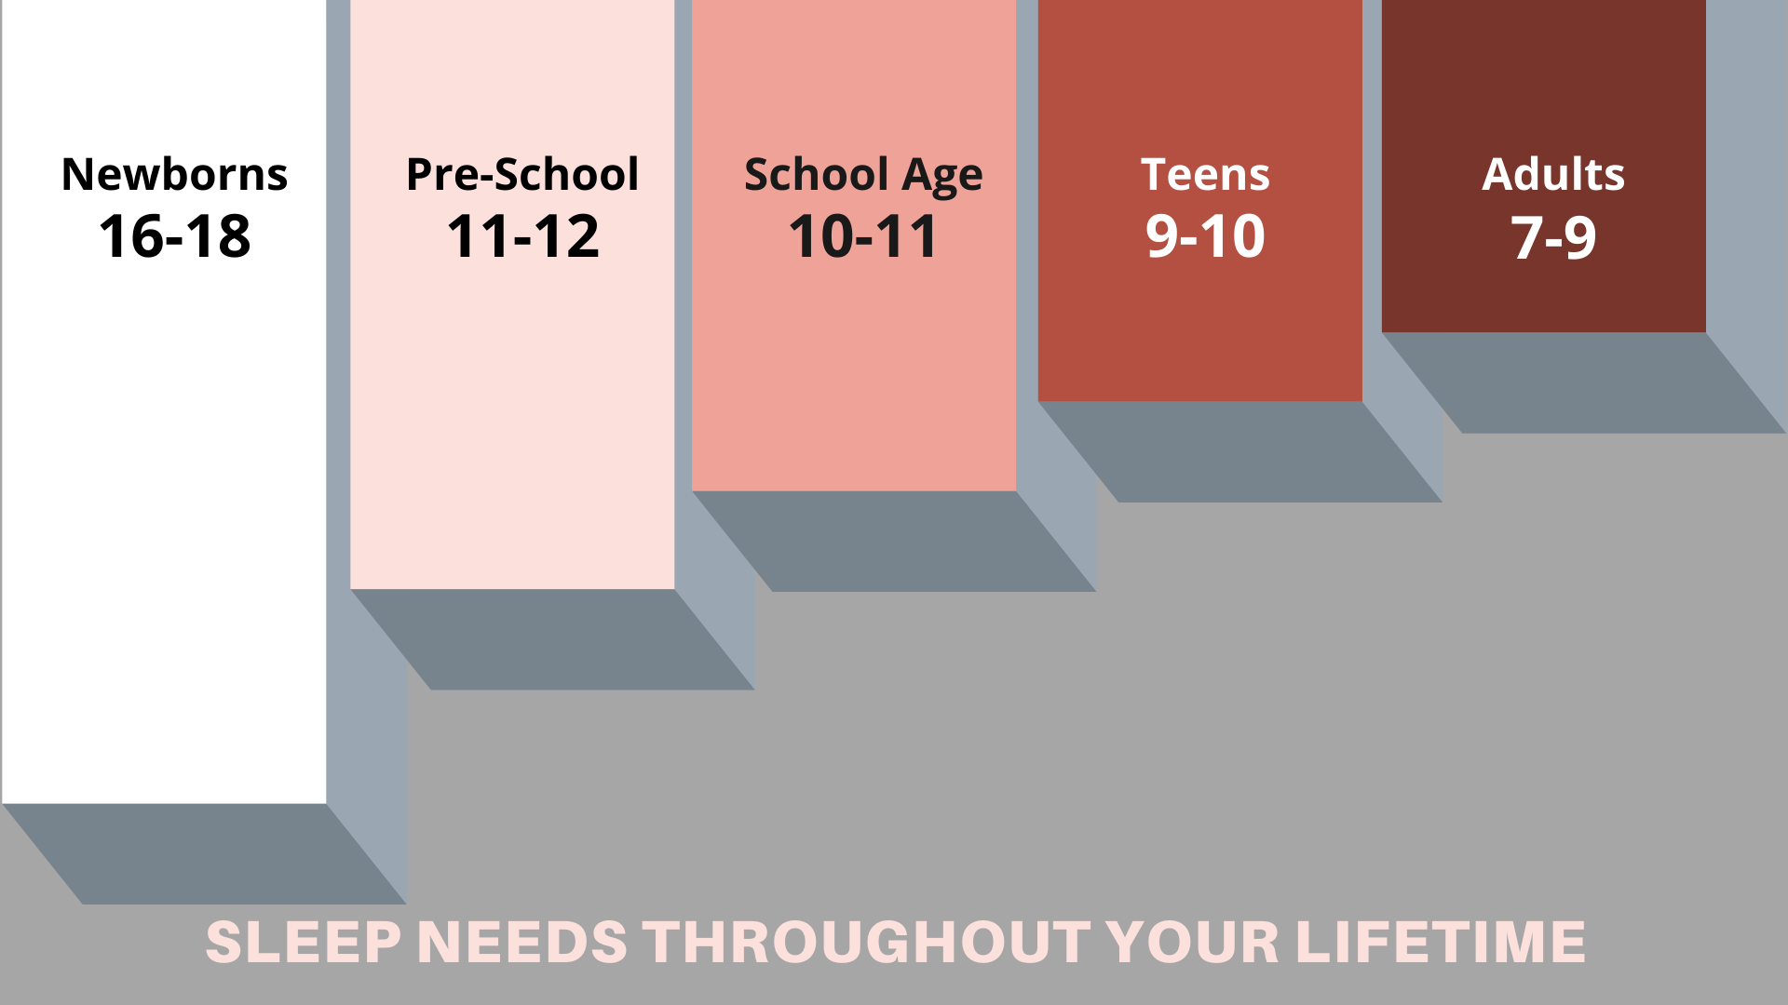
Notes:
When healthy adults are given unlimited opportunity to sleep, they sleep on average between 8 and 8.5 hours a night. But sleep needs vary from person to person. Some people appear to need only about 7 hours to avoid problem sleepiness, whereas others need 9 or more hours of sleep. Sleep needs also change throughout the life cycle. Newborns sleep between 16 and 18 hours a day, and children in preschool sleep between 11 and 12 hours a day. School-aged children and adolescents need at least 10 hours of sleep each night.
The hormonal influences of puberty tend to shift adolescents’ biological clocks. As a result, teenagers (who need between 9 and 10 hours of sleep a night) are more likely to go to bed later than younger children and adults, and they tend to want to sleep later in the morning. This delayed sleep–wake rhythm conflicts with the early-morning start times of many high schools and helps explain why most teenagers get an average of only 7–7.5 hours of sleep a night.
As people get older, the pattern of sleep also changes—especially the amount of time spent in deep sleep. This explains why children can sleep through loud noises and why they might not wake up when moved. Across the lifespan, the sleep period tends to advance, namely relative to teenagers; older adults tend to go to bed earlier and wake earlier. The quality—but not necessarily the quantity—of deep, non-REM sleep also changes, with a trend toward lighter sleep. The relative percentages of stages of sleep appear to stay mostly constant after infancy. From midlife through late life, people awaken more throughout the night. These sleep disruptions cause older people to lose more and more of stages 1 and 2 non-REM sleep as well as REM sleep.
Some older people complain of difficulty falling asleep, early morning awakenings, frequent and long awakenings during the
night, daytime sleepiness, and a lack of refreshing sleep. Many sleep problems, however, are not a natural part of sleep in the elderly. Their sleep complaints may be due, in part, to medical conditions, illnesses, or medications they are taking— all of which can disrupt sleep. In fact, one study found that the prevalence of sleep problems is very low in healthy older adults. Other causes of some of older adults’ sleep complaints are sleep apnea, restless legs syndrome, and other sleep disorders that become more common with age. Also, older people are more likely to have their sleep disrupted by the need to urinate during the night. Some evidence shows that the biological clock shifts in older people, so they are more apt to go to sleep earlier at night and wake up earlier in the morning. No evidence indicates that older people can get by with less sleep than younger people. Poor sleep in older people may result in excessive daytime sleepiness, attention and memory problems, depressed mood, and overuse of sleeping pills.
Despite variations in sleep quantity and quality, both related to age and between individuals, studies suggest that the optimal amount of sleep needed to perform adequately, avoid a sleep debt, and not have problem sleepiness during the day is about 7–9 hours for adults and at least 10 hours for school-aged children and adolescents. Similar amounts seem to be necessary to avoid an increased risk of developing obesity, diabetes, or cardiovascular diseases.

Slide 21

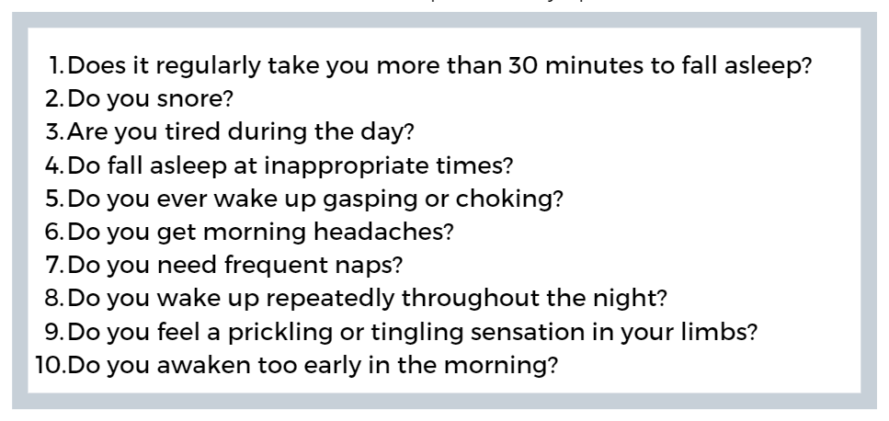
Is this a problem?
Any YES on the list scores you a talk with your doc!

Slide 22

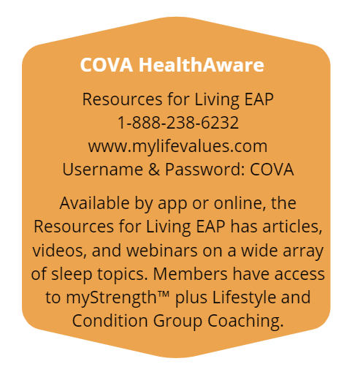
Notes:
Please refer to your specific health plan for information on coverage/benefits available for diagnosis and medically necessary treatment of sleep disorders. Each health plan has specific criteria/guidelines and benefits.

Slide 23
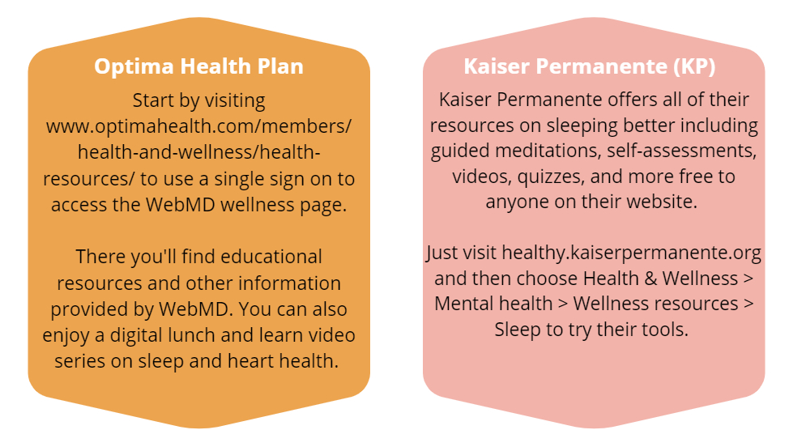

Slide 24
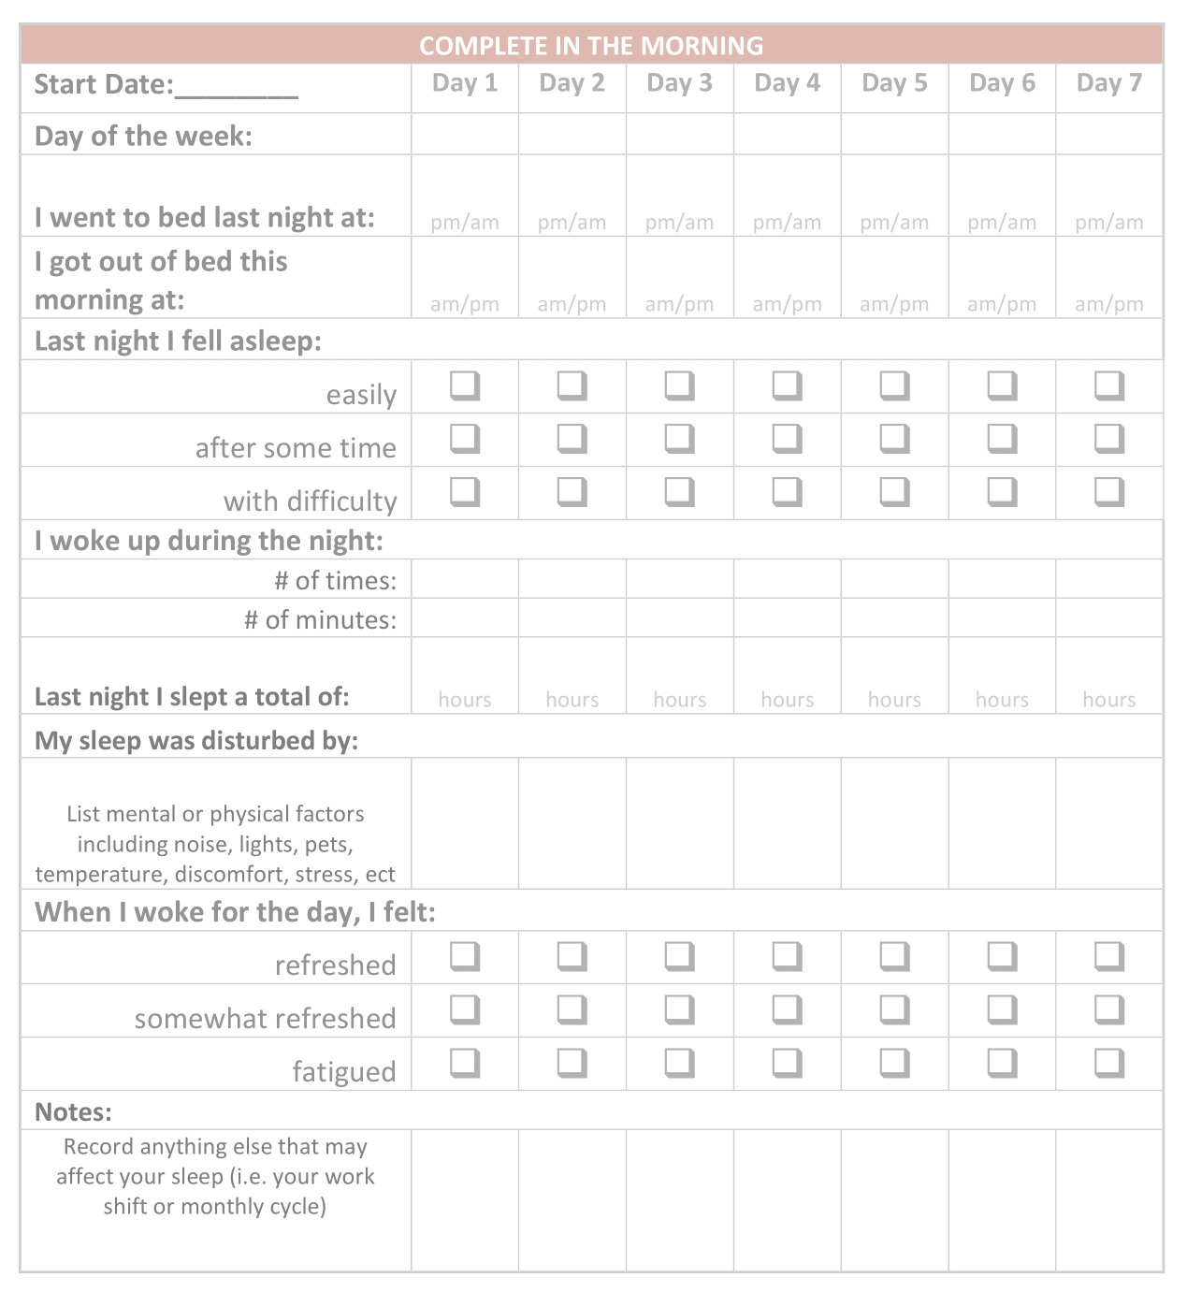
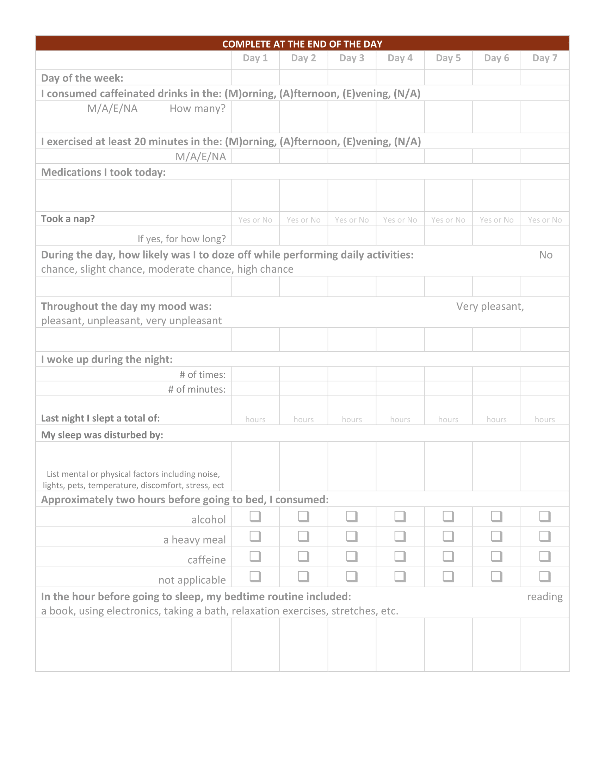
Sleep Journal

Slide 25
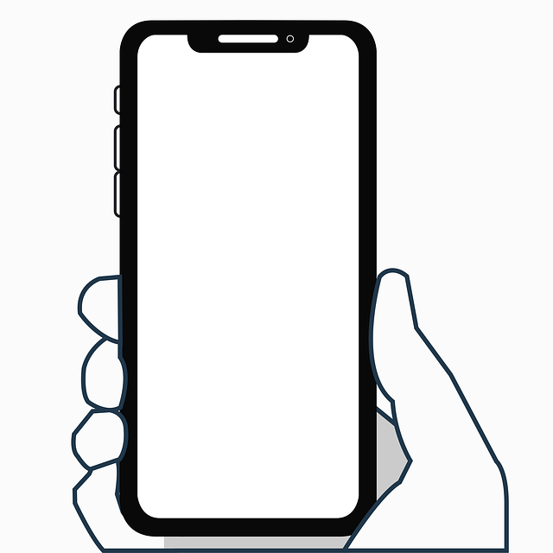

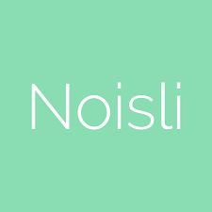


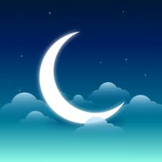
SLEEP CYCLE
SLUMBER
NOSILI
PZIZZ
HEADSPACE
SLEEP
APPS
Tracker
Bedtime stories
Learn meditation
Background sounds
Music, voice, and sound effects
Notes:
Struggling to catch enough ZZZs? – There’s an app for that! In fact, there are so many sleep apps that it can be hard to figure out which ones are worth a try. Whether you want to drift off to a meditation or a bedtime story, download one of these apps today to get the sleep you (so desperately) need.
Headspace – Headspace has made a name for itself as a meditation app, but it’s also great for sleep. The free version has “sleepcasts”, which are 45-55-minute-long audio experiences (kind of like adult bedtime stories) that help you visualize calming experiences, like a slow moving train or a walk through a garden. There are new stories every night, so you’ll never get bored. If you upgrade to the paid version, you’ll get access to more than 40 themed meditation courses (like for sleep or stress), plus many more sleepcast and music options to help you wind down.
Cost: Free for select content; $95/year for full access. Compatible with iOS and Android.
Pzizz – With Pzizz, you can set a timer for the length of sleep session so it plays a soothing dreamscape (read: combo of music, voiceovers, and sound effects) while you snooze; then, you can wake up to the build-in alarm. You’ll need to upgrade for more advanced features, like the ability to choose different sounds, but the app offers a 7-day free trial.
Cost: Free for select features; $60/year for full access. Compatible with iOS and Android.
Nosili – This super simple app lets you choose from a bunch of different sounds (like thunder, wind, white noise, and even the buzz of a coffee shop) to create your ideal sleep soundtrack. You can create a combo of sounds you love that you can save in the ap for future use. Pro tip: If you’re using it overnight, keep your phone plugged in… otherwise, you may wake up to a dead battery.
Cost: $2, website is free.
Slumber – Slumber offers a combination of experiences to help you fall asleep, whether it’s meditation focused, a 6-part bedtime story series, or the sound of a warm jacuzzi. You can also choose a background noise (like rain or the ocean) to play for up to 10 hours after the main track ends. New sleep-inducing stories and meditations are added each week, and you can listen to them all if you upgrade to the premium version (otherwise, you can get many episodes for free).
Cost: Free for 10+ episodes; $40/year for full access. Only available on iOS.
Sleep Cycle – If you want to learn how you slept, the Sleep Cycle app is for you. It tracks your sleep patterns and provides tips to optimize your snooze time. Plus, it has an alarm clock that gently wakes you up when you’re in your lightest sleep phase so you’ll wake up feeling refreshed. Just keep in mind that no sleep tracker is 100% accurate, so if you’re struggling with your sleep, you may need to see a dedicated sleep specialist.
Cost: Free. Compatible with iOS and Android.
Calm – Calm’s app is super easy to use, and the Sleep Stories section has bedtime stories (for kids and adults) read aloud by people with soothing voices, including celebrities like Matthew McConaughey. Only a few stories are included for free, but getting a subscription unlocks a huge library of meditations made specifically for sleep… plus categories like stress and ASMR.
Cost: Free for some features; $70/year for full access (includes a 7-day free trial).
10% Happier – If you still haven’t found a sleep app that works for you, 10% Happier is worth a shot. It offers a wide range of meditations – including ones for sleep – that range from 3 minutes to 45 minutes to help you relax and fall asleep. There are also meditation courses spanning a variety of genres and the option to message a coach for extra support.
Cost: Free for one session; $15/month or $100/year for a subscription. Compatible with iOS and Android.

Slide 26
Have you tried…
eating earlier
gentle stretching
getting cooled off
a few easy leg exercises
writing down your thoughts
cutting out caffeine late in the day
sleeping in a fresh bed or on the couch writing your to-do list before bed
using white noise or ear plugs
visualizing yourself sleeping
a warm shower before bed
talking to your doctor

Slide 27


Thank you for participating!
Please take a moment and give us your feedback at:
https://tinyurl.com/BetterNightsAhead
Visit
CommonHealth.Virginia.Gov

